Slide 1
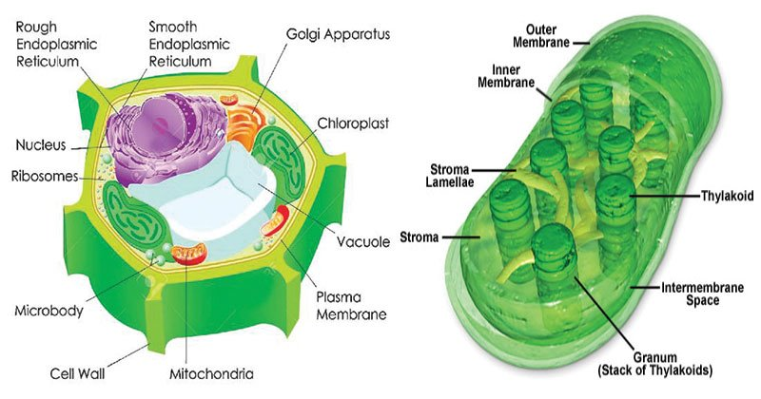
CHLOROPLASTS

Slide 2
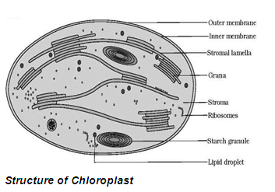
CHLOROPLAST
Chloroplast, structure within the cells of plants and green algae that is the site of photosynthesis, the process by which light energy is converted to chemical energy, resulting in the production of oxygen and energy-rich organic compounds. Photosynthetic cyanobacteria are free-living close relatives of chloroplasts; endosymbiotic theory posits that chloroplasts and mitochondria (energy-producing organelles in eukaryotic cells) are descended from such organisms.

Slide 3
Characteristics of chloroplast
Chloroplasts are a type of plastid—a round, oval, or disk-shaped body that is involved in the synthesis and storage of foodstuffs. Chloroplasts are distinguished from other types of plastids by their green colour, which results from the presence of two pigments, chlorophyll a and chlorophyll b. A function of those pigments is to absorb light energy for the process of photosynthesis. Other pigments, such as carotenoids, are also present in chloroplasts and serve as accessory pigments, trapping solar energy and passing it to chlorophyll. In plants, chloroplasts occur in all green tissues, though they are concentrated particularly in the parenchyma cells of the leaf mesophyll.
Chloroplasts are roughly 1–2 μm (1 μm = 0.001 mm) thick and 5–7 μm in diameter. They are enclosed in a chloroplast envelope, which consists of a double membrane with outer and inner layers, between which is a gap called the intermembrane space. A third, internal membrane, extensively folded and characterized by the presence of closed disks (or thylakoids), is known as the thylakoid membrane.

Slide 4
Marker Enzyme of Chloroplast
The marker enzymes of chloroplast include RUBISCO, NADP-Reductase, ATP synthase, Glyceraldehyde-3-phosphate dehydrogenase, and chlorophyllase etc.
There are certain enzymes present in chloroplast some are known for their activity on photosynthesis while some are known for their action on different metabolism of plant…
1. NADP-REDUCTASE - This enzyme is present in the grana thylakoid on the stroma side of chloroplast. This enzyme is helpful in light reaction of photosynthesis and is responsible for creating energy gradient in the chloroplast.
2. Phosphoenol pyruvate- This enzyme is present in mesophyll cell in C4-plants . It is important here to remember that this enzyme is not present in C3 plants. They only have Rubisco. In C4-plants PEP functions a primary CO2 acceptor and is responsible for fixation of PEP CARBOXYLASE.
3. PHOTOSYSTEM - II - An enzyme present in the thylakoid membrane which plays a major functions in non-cyclic photophosphorylation and is responsible for splitting of water to 2H+,[O] and electron. This electron is responsible for replacing those removed from photosystem I.
5

Slide 5
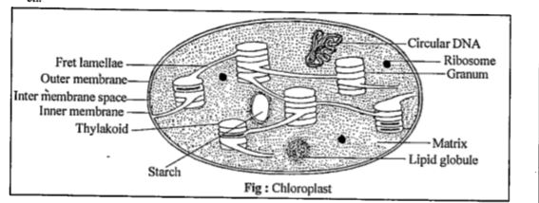
Semi-autonomous nature of chloroplast
Chloroplasts are also semi-autonomous organelles found in plant cells and other photosynthetic eukaryotes. Chloroplasts use light energy to synthesize ATP and sugar molecules. Like mitochondria, chloroplasts reproduce by binary fission, but unlike mitochondria they have a three-membrane structure. In addition to an outer membrane and an inner membrane, chloroplasts also contain thylakoid membranes found inside the interior, or stroma, of the inner membrane. Like mitochondria, chloroplasts contain circular DNA and ribosomes, and are able to synthesize a number of the proteins that function within the organelle. In the lower left, we see an image of algal cells in which the chloroplast are readily visible due to the presence of light absorbing chlorophyll.

Slide 6
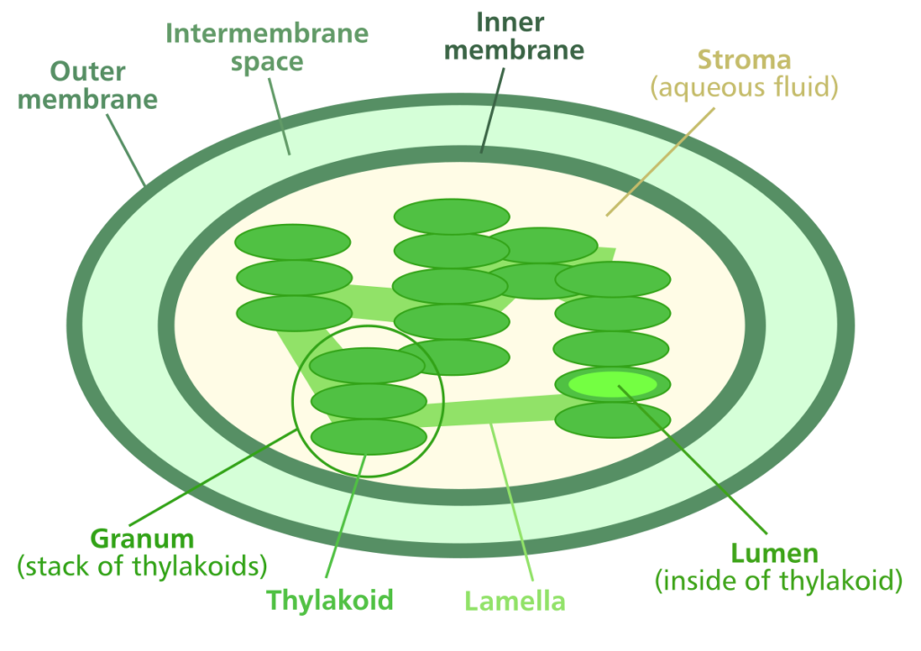
Composition of chloroplast
  Chloroplasts contain proteins, lipids, and chlorophyll, carotenoids, RNA and DNA. Starch granules or osmiophillic droplets are also present in it.
  Proteins form a part of chloroplast membrane and lamellae, and are also present in the matrix in the form of enzymes.
  Lipids are mainly phospholipids, fats, sterols and waxes found in the lamellae and wall of the plastid.
  Chlorophyll is of two types-chlorophyll a and chlorophyll b. These are found in green plants and algae. Chlorophyll is an asymmetrical molecule having a hydrophyllic head made of four pyrrole rings bound to each other to form a porphyrin ring. This part of the molecule is similar to haemoglobin and cytochromes.

Slide 7
In chlorophyll, however, there is a Mg atom forming a complex with four rings (In animal pigments the Mg is replaced by Fe).Chlorophyll has a long hydrophobic chain attached to one of the rings. In chlorophyll b there is a —CHO group in place of the —CH₃ group.
Chlorophyll absorbs light mainly in the red region of the spectrum which causes the green colour of green plants.
Chlorophyll molecules are disposed with in the thylakoid membrane in close association with integral proteins forming several complexes that have important functions in photosynthesis.
Carbohydrates are found in a very low percentage and in chloroplasts the common carbohydrates are starch and sugar phosphates.
DNA molecule in chloroplast was first of all reported by Ris and Plaut (1962) in Chlamydomonas (alga) and later it was reported in chloroplasts of other algae and higher plants. Chloroplast DNA resembles closely with bacterial DNA and differs from nuclear DNA in many respects.
RNA is found in ribosomes of plastids. RNAs are of two types—24S rRNA and 16S rRNA. In chloroplasts are also found aminoacyl-tRNAs, aminoacyl-tRNA synthetases and methionyl-tRNA.

